Slide 1
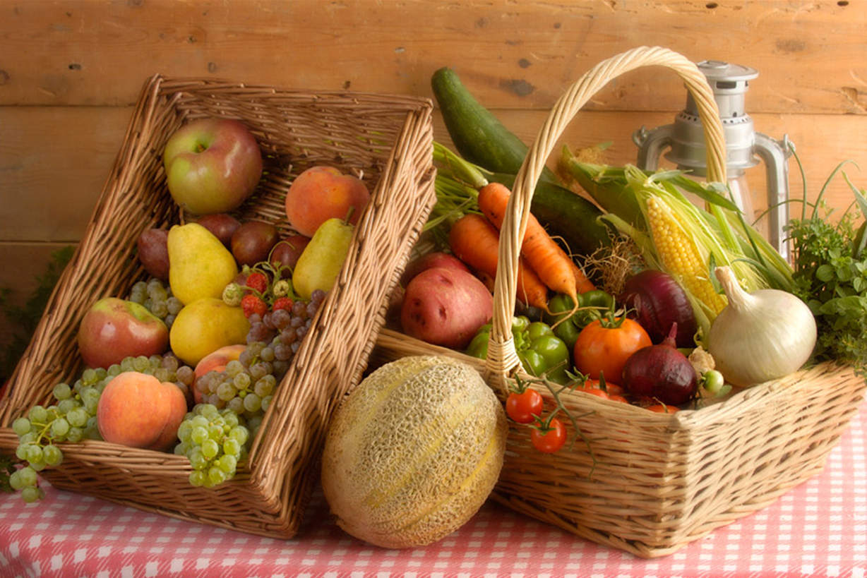
Chef Anthony Simini
Rockland County BOCES Adult Ed. Culinary Classes

Slide 2
Rockland County BOCES Adult Education Culinary Classes

Slide 3
Rockland County BOCES Adult Education
Culinary Classes
Concept / Ratio Cooking | Home Catering 101
Tour of Italy | Healthy Cooking is a Priority
Tour De France | Soup Cooking 101
Tour of Europe | Latino (Cruise the Caribbean)
Cooking for the Four Seasons | Everyone Loves Pasta
HOLIDAY DESSERTS WITH A TWIST | KITCHEN SKILLS 101

Slide 4
Adult ED BOCES Culinary Classes
Concept / Ratio Cooking
Concept / Ratio Cooking (The Rosetta Stone of Cooking)
Description: This class will teach the proper cooking techniques without the research and requirements of a recipe. The instructor will teach the students how to take typical entrée items from your favorite marketplace, weekly supermarket fliers and marry these ingredients together week after week into delicious tasty meals. The concept is based on a regional flavor chart and several key concepts to bring a meal together without the burden of a cookbook prior to shopping to assemble ingredients.
What is the Regional Flavor Chart?
The Regional Flavor Chart is a grid of international groups (i.e. Italian, Asian, Greek, French, Latino, etc.) that list the key secondary key ingredients in a targeted culture that make up the regional flavoring agents in an expected palate. Example, the best way to explain is the breakdown of a typical Italian tomato sauce. The tomatoes are the main ingredient in a tomato sauce but the sauce is not complete without several “key” Italian ingredients that bind everything together. The “secondary” ingredients are garlic, onion, parsley and basil. These components give the dish the characteristics that make it Italian. The same concept applies to every dish we cook. Note – See Appendix for details.

Slide 5
Adult ED BOCES Culinary Classes
Concept / Ratio Cooking – How Does This Work?
Regional Flavoring Agents
In hindsight, what if I wanted Italian, not French? I would have kept the pork chops, plum tomatoes and mushrooms but replaced the following: White wine ➔ Red or Marsala wine Shallots ➔ garlic Brown gravy ➔ can of tomato sauce Thyme ➔ Italian parsley Tarragon ➔ basil Artichoke hearts ➔ Porcini mushrooms | Wait a minute, I wanted Spanish! I would have kept the pork chops, plum tomatoes and mushrooms but replaced the following: White wine ➔ Mexican Beer Shallots ➔ garlic Brown gravy ➔ can of tomato sauce Thyme ➔ cilantro Tarragon ➔ jalapenos Artichoke hearts ➔ tomatillo

Slide 6
Adult ED BOCES Culinary Classes
Healthy Cooking is a Priority
Searing technique on fish, chicken, pork, etc-etc accompanied with low-fat salsas, chutneys and yogurt sauces
Converting some of our favorite high calorie dishes into a lighter side
New tasty foods with great health benefits
Incorporate “Super-Foods” into our diets and meals
Dishes and ideas that lower fat, carbs and calories
Flourless Pizza!

Slide 7
Adult ED BOCES Culinary Classes
HOLIDAY DESSERTS WITH A TWIST
With the holidays around the corner, Chef Anthony will demonstrate a new twist on the Fall season's holiday classics. Plenty of sampling for everyone!

Slide 8
Adult ED BOCES Culinary Classes
KITCHEN SKILLS 101
Chef Anthony will teach you knife and organizational skills within the kitchen. Lessons on prepping dinner for the week and the fundamentals of homemade stocks and soup cookery. With the holidays around the corner, Chef Anthony will demonstrate a new twist on the Fall season's holiday classics. Plenty of sampling for everyone!

Slide 9
Adult ED BOCES Culinary Classes
Tour of Italy
This is a 2 day class separating the cuisines around the country of Italy. Day One, the chef will demonstrate with the help of his students, Italy’s most famous Northern and Roman cuisine. In the second session, you will drive down the Amalfi Coast and into Sicily. Again, the chef will demonstrate the tasty bounties Italy has to offer based on regional flavors around the boot! This is a chef demo class and students hands-on cooking.

Slide 10
Adult ED BOCES Culinary Classes
Tour De France
This is a 2 day class separating the cuisines around the country of France. Day One, the chef will demonstrate with the help of his students, France’s most famous cuisines from Paris, Bordeaux and Lyon (the food capital of the world). In the second session, you will head south to the Basque region and French Rivera. The chef will demonstrate why French cuisine is the quintessential component to all cooking. What makes French techniques universal is that they are based on logic. Sautéing, roasting, braising, poaching, broiling—they all have a reason to be used. This is a chef demo class and students hands-on cooking.

Slide 11
Adult ED BOCES Culinary Classes
Cooking for the Four Seasons
Description: “Cooking for the Four Seasons” (Summer, Fall, Winter & Spring) is a cooking class based on the time of year, what foods are in season during that timeframe, and the different cooking techniques....
Summer - Light with fresh vegetables, fruit, salads, and grilling techniques.
Fall - Football snacks, roasting, soups, squashes, apples, game meat...
Winter - Stews and root vegetables are in (stick to the rib type food to warm the soul).
Spring - Omelets / frittata, fish (e.g. trout), cherries, sprout vegetables… This class is both hands-on and instructor led with classroom lectures, chef demos and students’ hands-on.

Slide 12
Adult ED BOCES Culinary Classes
Home Catering 101
Hosting a dinner party for family or friends? Uncertain how much food to cook or what foods are best for specific functions/holidays? How does a chef execute entire 5-7 course meal-each course served piping hot and the host is still able to have a great time? If quandaries like this put a damper on dinner parties, then this class is for you! The chef will show you how to “layer” the preparation for multi course meals and plan the execution of each course so the food is fresh \ hot and most important, the host can enjoy the event with their guest.

Slide 13
Adult ED BOCES Culinary Classes
Soup Cooking 101
Description: Making soup is magical – all the nutrition, vitamins and flavors are captured into one pot - a harmony of delight! This is a one day class that will teach you the basic fundamentals of building a soup. It will teach you the basic soup ingredients, terms and base (broth) foundations to layer a soup. Instructor will demonstrate broth, creamed (chowder) and vegetable soups.
Soup Types: Broth – Chicken Ramen Noodle Soup Chowder – Corn Chowder Vegetable – Minestrone | Chef Demo: Chicken stock Vegetable stock Vegetable cuts for soup Roux and other thicken agents “One-Pot-Method” Vegetarian vs non- vegetarian soups

Slide 14
Adult ED BOCES Culinary Classes
Latino (Cruise the Caribbean)
The chef will take you across the Caribbean, through Mexico and down into South America! We will cook pork, chicken and fish exploding with citrus flavors, an assortment of chilies, and wrapped up with cultural techniques and flavors!

Slide 15
Everyone loves pasta!
Description: Anthony will teach you the basics of making homemade pasta and all the classic signature dishes throughout the regions of Italy.

Slide 16
Tour of Europe
Starting West on the beaches of Portugal eating the bounty of the sea. Next stop is France, classic dish from Lyon, 'world capital of gastronomy’. Then everyone’s favorite, Italy – the art of pasta. Next stop is Germany and then Austria for their famous desserts.

Slide 17
Concept / Ratio Cooking
Appendix (International Flavoring Chart – Cheat Sheet)

Slide 18
Concept / Ratio Cooking
Appendix (International Flavoring Chart) Continues…

